Slide 1
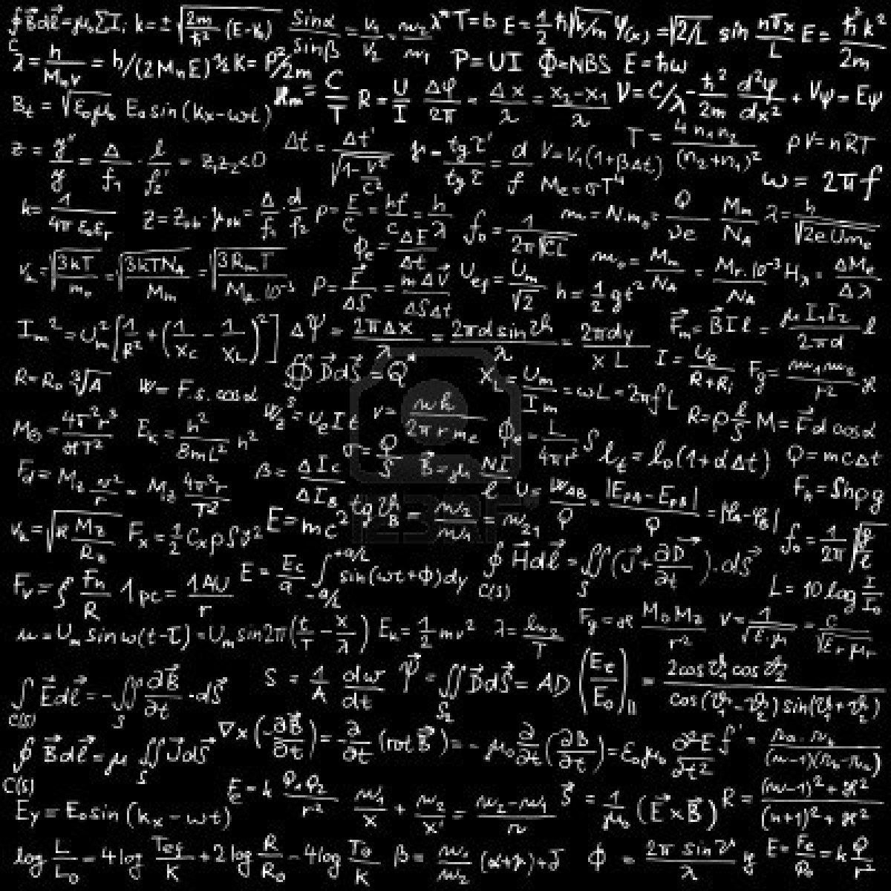
al-Farabi Kazakh National University
PARTIAL DIFFERENTIAL EQUATIONS
Professor S. Serovajsky
serovajskys@mail.ru
Almaty, 2021

Slide 2
Partial differential equations
2
Part I
INTRODUCTION

Slide 3
Content of Part I
3
What is this?
Why it is important?
How can we begin to analyze it?

Slide 4
What do we know?
4
Partial differential equations are extensions of the ordinary differential equations to the case where unknown function depends from many variables

Slide 5
What do we know?
4
Partial differential equations are extensions of the ordinary differential equations to the case where unknown function depends from many variables
Partial differential equations are mathematical models of many physical (and not only physical) phenomena

Slide 6
Partial differential equations
Part I. INTRODUCTION
Lecture 3
Classification
of partial differential equations

Slide 7
Content of lecture
6
Simplification of partial differential equations

Slide 8
Content of lecture
6
Simplification of partial differential equations
Characteristic equation of partial differential equation

Slide 9
Content of lecture
6
Simplification of partial differential equations
Characteristic equation of partial differential equation
Classification of partial differential equations

Slide 10
Content of lecture
6
Simplification of partial differential equations
Characteristic equation of partial differential equation
Classification of partial differential equations
Canonic forms of partial differential equations

Slide 11
Introduction
7
Class of partial differential equations is very large

Slide 12
Introduction
7
Class of partial differential equations is very large
We would like to simplify the partial differential equation

Slide 13
Introduction
7
Class of partial differential equations is very large
We would like to simplify the partial differential equation
We change the independent variables
such that the equation with new variables has as soon as easy form,
which is called the canonic form

Slide 14
Introduction
7
Class of partial differential equations is very large
We would like to simplify the partial differential equation
We change the independent variables
such that the equation with new variables has as soon as easy form,
which is called the canonic form
Canonic forms are the basis of its classification

Slide 15
Introduction
7
Class of partial differential equations is very large
We would like to simplify the partial differential equation
We change the independent variables
such that the equation with new variables has as soon as easy form,
which is called the canonic form
Canonic forms are the basis of its classification
Then we will analyze the canonic form only

Slide 16
Object of analysis
8
Considered mathematical models are described by
second order partial differential equations

Slide 17
Object of analysis
8
Considered mathematical models are described by
second order partial differential equations
Easiest case of partial differential equations is two-dimensional

Slide 18
Object of analysis
8
Considered mathematical models are described by
second order partial differential equations
Easiest case of partial differential equations is two-dimensional
General form of second order partial differential equation
with two independent variables

Slide 19
Object of analysis
8
Considered mathematical models are described by
second order partial differential equations
Easiest case of partial differential equations is two-dimensional
General form of second order partial differential equation
with two independent variables
Consider the linear equation with respect to the high derivatives
where a_{ij} = a_{ij}(x,y)

Slide 20
Object of analysis
8
Considered mathematical models are described by
second order partial differential equations
Easiest case of partial differential equations is two-dimensional
General form of second order partial differential equation
with two independent variables
Consider the linear equation with respect to the high derivatives
where a_{ij} = a_{ij}(x,y)
Why we use the coefficient 2 before a₁₂?

Slide 21
Change of the independent variables
9
Determine new independent variables

Slide 22
Change of the independent variables
9
Determine new independent variables
We choose these independent variables
such that the equation with respect to the new variables
are as soon as easy

Slide 23
Change of the independent variables
9
Determine new independent variables
We choose these independent variables
such that the equation with respect to the new variables
are as soon as easy
After analysis of the system in new variables
we can return to initial variables
using the inverse transformation

Slide 24
Change of the independent variables. 2
10
Let v be the solution of the considered equation in new variables

Slide 25
Change of the independent variables. 2
10
Let v be the solution of the considered equation in new variables
We have the following equalities

Slide 26
Change of the independent variables. 2
10
Let v be the solution of the considered equation in new variables
We have the following equalities
Find the derivatives (differentiation of composite function)

Slide 27
Change of the independent variables. 2
10
Let v be the solution of the considered equation in new variables
We have the following equalities
Find the derivatives
Find second derivatives

Slide 28
Change of the independent variables. 3
11
Second derivatives:

Slide 29
Change of the independent variables. 3
11
Second derivatives:
Put all results to the given equation

Slide 30
Change of the independent variables. 3
11
Second derivatives:
Put all results to the given equation
We obtain the equation for the function v
that is linear with respect to the second derivatives

Slide 31
Change of the independent variables. 4
12
_{Equation in new variables}
where

Slide 32
Change of the independent variables. 4
12
_{Equation in new variables}
where
What is the sense of these transformations?

Slide 33
Change of the independent variables. 4
12
_{Equation in new variables}
where
What is the sense of these transformations?
We choose the new variable such that
the equation in new variable will be as soon as easy

Slide 34
Change of the independent variables. 4
12
_{Equation in new variables}
where
What is the sense of these transformations?
We choose the new variable such that
the equation in new variable will be as soon as easy
Try to equal to zero one of the coefficient of the obtained equation

Slide 35
Characteristic equation
13
The ordinary differential equation
is called the characteristic equation for the equation

Slide 36
Characteristic equation
13
The ordinary differential equation
is called the characteristic equation for the equation
Lemma
If ϕ(x,y)=c, where c is an arbitrary constant, is the general solution
of the characteristic equation,
then the function ϕ satisfies the equation

Slide 37
Proof
14
Suppose ϕ(x,y)=c is the general solution of the equation

Slide 38
Proof
14
Suppose ϕ(x,y)=c is the general solution of the equation

Slide 39
Proof
14
Suppose ϕ(x,y)=c is the general solution of the equation
Using the equalityϕ(x,y)=c, determine

Slide 40
Proof
14
Suppose ϕ(x,y)=c is the general solution of the equation
Using the equalityϕ(x,y)=c, determine

Slide 41
Proof
14
Suppose ϕ(x,y)=c is the general solution of the equation
Using the equalityϕ(x,y)=c, determine
Put it to the previous equation

Slide 42
Proof. 2
15

Slide 43
Proof. 2
15
We get

Slide 44
Proof. 2
15
We get

Slide 45
Proof. 2
15
We get
Conclusion?

Slide 46
Characteristic equation
16
Equation in new variables
where

Slide 47
Characteristic equation
16
Equation in new variables
where
If ϕ(x,y)=c is the general solution of the equation
then the function ϕ satisfies the equation

Slide 48
Classification of equations. 2
17
Characteristic equation

Slide 49
Classification of equations. 2
17
Characteristic equation
How we can analyze it?

Slide 50
Classification of equations. 2
17
Characteristic equation
How we can analyze it?

Slide 51
Classification of equations. 2
17
Characteristic equation
How we can analyze it?
Conclusion?

Slide 52
Classification of equations. 2
17
Characteristic equation
How we can analyze it?
Conclusion?
Result depends from the sigh of the value
that is called the discriminant

Slide 53
Classification of equations. 3
18
Definition

Slide 54
Classification of equations. 3
18
Definition
The equation is called hyperbolic if
parabolic if
and elliptic if

Slide 55
Classification of equations. 3
18
Definition
The equation is called hyperbolic if
parabolic if
and elliptic if
Remark. For the equations with variable coefficients the equation can
have the different type at the different points.

Slide 56
Classification of equations. 3
18
Definition
The equation is called hyperbolic if
parabolic if
and elliptic if
Remark. For the equations with variable coefficients the equation can
have the different type at the different points.
What is the type of the heat equation u_{t} = a²u_{xx} ?

Slide 57
Classification of equations. 3
18
Definition
The equation is called hyperbolic if
parabolic if
and elliptic if
Remark. For the equations with variable coefficients the equation can
have the different type at the different points.
What is the type of the heat equation u_{t} = a²u_{xx} ?
What is the type of the string vibration equation u_{t} = a²u_{xx} ?

Slide 58
Classification of equations. 3
18
Definition
The equation is called hyperbolic if
parabolic if
and elliptic if
Remark. For the equations with variable coefficients the equation can
have the different type at the different points.
What is the type of the heat equation u_{t} = a²u_{xx} ?
What is the type of the string vibration equation u_{t} = a²u_{xx} ?
What is the type of the Poisson equation u_{xx} + u_{yy} = f ?

Slide 59
Hyperbolic equations
19
where

Slide 60
Hyperbolic equations
19
where
D>0, we have two characteristic equations

Slide 61
Hyperbolic equations
19
where
D>0, we have two characteristic equations
Let ϕ(x,y)=c and ψ(x,y)=c are its general solutions

Slide 62
Hyperbolic equations
19
where
D>0, we have two characteristic equations
Let ϕ(x,y)=c and ψ(x,y)=c are its general solutions

Slide 63
Hyperbolic equations. 2
20
Canonic form of hyperbolic equations

Slide 64
Hyperbolic equations. 2
20
Canonic form of hyperbolic equations

Slide 65
Hyperbolic equations. 2
20
Canonic form of hyperbolic equations

Slide 66
Hyperbolic equations. 2
20
Canonic form of hyperbolic equations
Second canonic form of hyperbolic equations

Slide 67
Hyperbolic equations. 3
21
Example

Slide 68
Hyperbolic equations. 3
21
Example

Slide 69
Hyperbolic equations. 3
21
Example
D = ???

Slide 70
Hyperbolic equations. 3
21
Example
D = 1
Characteristic equations ???

Slide 71
Hyperbolic equations. 3
21
Example
D = 1
Characteristic equations y' =3 and y' =1

Slide 72
Hyperbolic equations. 3
21
Example
D = 1
Characteristic equations y' =3 and y’ =1
General solutions ???

Slide 73
Hyperbolic equations. 3
21
Example
D = 1
Characteristic equations y' =3 and y’ =1
General solutions: y-3x=c and y-x=c

Slide 74
Hyperbolic equations. 3
21
Example
D = 1
Characteristic equations y' =3 and y’ =1
General solutions: y-3x=c and y-x=c
New variables ???

Slide 75
Hyperbolic equations. 3
21
Example
D = 1
Characteristic equations y' =3 and y’ =1
General solutions: y-3x=c and y-x=c
New variables ξ = y-3x and η = y-x

Slide 76
Hyperbolic equations. 3
21
Example
D = 1
Characteristic equations y' =3 and y’ =1
General solutions: y-3x=c and y-x=c
New variables ξ = y-3x and η = y-x

Slide 77
Hyperbolic equations. 3
21
Example
D = 1
Characteristic equations y' =3 and y’ =1
General solutions: y-3x=c and y-x=c
New variables ξ = y-3x and η = y-x

Slide 78
Parabolic equations
22
where

Slide 79
Parabolic equations
22
where
D=0, we have unique characteristic equation

Slide 80
Parabolic equations
22
where
D=0, we have unique characteristic equation
Let ϕ(x,y)=c is its general solutions

Slide 81
Parabolic equations
22
where
D=0, we have unique characteristic equation
Let ϕ(x,y)=c is its general solutions

Slide 82
Parabolic equations. 2
23
We have
because

Slide 83
Parabolic equations. 2
23
We have
because
Determine

Slide 84
Parabolic equations. 2
23
We have
because
Determine
Conclusion:

Slide 85
Parabolic equations. 2
23
We have
because
Determine
Conclusion:
Canonic form of parabolic equations

Slide 86
Parabolic equations. 3
24
Example

Slide 87
Parabolic equations. 3
24
Example

Slide 88
Parabolic equations. 3
24
Example
D = ???

Slide 89
Parabolic equations. 3
24
Example
D = 0
Characteristic equation ???

Slide 90
Parabolic equations. 3
24
Example
D = 0
Characteristic equation y' = 2
New variable ???

Slide 91
Parabolic equations. 3
24
Example
D = 0
Characteristic equation y' = 2
New variable ξ = y-2x

Slide 92
Parabolic equations. 3
24
Example
D = 0
Characteristic equation y' = 2
New variable ξ = y-2x
How we can choose η ?

Slide 93
Parabolic equations. 3
24
Example
D = 0
Characteristic equation y' = 2
New variable ξ = y-2x
η is arbitrary, for example η=x

Slide 94
Parabolic equations. 3
24
Example
D = 0
Characteristic equation y' = 2
New variable ξ = y-2x
η is arbitrary, for example η=x

Slide 95
Elliptic equations
25
where

Slide 96
Elliptic equations
25
where
D<0, we have characteristic equations with complex parameters

Slide 97
Elliptic equations
25
where
D<0, we have characteristic equations with complex parameters
Let ϕ(x,y)=c and ϕ*(x,y)=c are its general solutions.

Slide 98
Elliptic equations
25
where
D<0, we have characteristic equations with complex parameters
Let ϕ(x,y)=c and ϕ*(x,y)=c are its general solutions.
What is relation between ϕ and ϕ*?

Slide 99
Elliptic equations. 2
26
Determine

Slide 100
Elliptic equations. 2
26
Determine
By the lemma

Slide 101
Elliptic equations. 2
26
Determine
By the lemma
But this an equation with complex coefficients

Slide 102
Elliptic equations. 2
26
Determine
By the lemma
But this an equation with complex coefficients
Determine the new variables

Slide 103
Elliptic equations. 2
26
Determine
By the lemma
But this an equation with complex coefficients
Determine the new variables

Slide 104
Elliptic equations. 3
27
We have

Slide 105
Elliptic equations. 3
27
We have
Conclusion?

Slide 106
Elliptic equations. 3
27
We have
Conclusion?
We can choose α and β,
i.e. real and imagine parts of the function ϕ
as new independent variables

Slide 107
Elliptic equations. 3
27
We have
Conclusion?
We can choose α and β,
i.e. real and imagine parts of the function ϕ
as new independent variables

Slide 108
Elliptic equations. 3
27
We have
Conclusion?
We can choose α and β,
i.e. real and imagine parts of the function ϕ
as new independent variables
Canonic form of elliptic equations

Slide 109
Elliptic equations. 4
28
Example

Slide 110
Elliptic equations. 4
28
Example

Slide 111
Elliptic equations. 4
28
Example
D = ???

Slide 112
Elliptic equations. 4
28
Example
D = -1
What is a characteristic equation?

Slide 113
Elliptic equations. 4
28
Example
D = -1
y' =2±i.
What is its general solution?

Slide 114
Elliptic equations. 4
28
Example
D = -1
y' =2±i.
y-2x+ix=c and y-2x-ix=c
How we determine the new variables?

Slide 115
Elliptic equations. 4
28
Example
D = -1
y' =2±i.
y-2x+ix=c and y-2x-ix=c
ξ = y-2x and η=x

Slide 116
Elliptic equations. 4
28
Example
D = -1
y' =2±i.
y-2x+ix=c and y-2x-ix=c
ξ = y-2x and η=x

Slide 117
Elliptic equations. 4
28
Example
D = -1
y' =2±i.
y-2x+ix=c and y-2x-ix=c
ξ = y-2x and η=x

Slide 118
Conclusions
29
Partial differential equations can be simplified using new variables

Slide 119
Conclusions
29
Partial differential equations can be simplified using new variables
Characteristic equation is a meaning of simplification of partial differential equations

Slide 120
Conclusions
29
Partial differential equations can be simplified using new variables
Characteristic equation is a meaning of simplification of partial differential equations
Classification of partial differential equations depends of the sign of the discriminant

Slide 121
Conclusions
29
Partial differential equations can be simplified using new variables
Characteristic equation is a meaning of simplification of partial differential equations
Classification of partial differential equations depends of the sign of the discriminant
Equation is hyperbolic if its discriminant is positive, parabolic if it is zero, and elliptic if it is negative

Slide 122
Conclusions
30
Vibrating string equation is hyperbolic

Slide 123
Conclusions
30
Vibrating string equation is hyperbolic
Heat equation is parabolic

Slide 124
Conclusions
30
Vibrating string equation is hyperbolic
Heat equation is parabolic
Poisson equation is elliptic

Slide 125
Conclusions
30
Vibrating string equation is hyperbolic
Heat equation is parabolic
Poisson equation is elliptic
Any equation can be reduced to the canonic form

Slide 126
Conclusions
30
Vibrating string equation is hyperbolic
Heat equation is parabolic
Poisson equation is elliptic
Any equation can be reduced to the canonic form
Equation canonic form depends from the type of equation

Slide 127
Conclusions
31
To reduce the hyperbolic equation to canonical form, two general solutions of the characteristic equation are used as new variables

Slide 128
Conclusions
31
To reduce the hyperbolic equation to canonical form, two general solutions of the characteristic equation are used as new variables
To reduce the parabolic equation to canonical form, the general solution of the characteristic equation is used as new variable; second variable can be arbitrary

Slide 129
Conclusions
31
To reduce the hyperbolic equation to canonical form, two general solutions of the characteristic equation are used as new variables
To reduce the parabolic equation to canonical form, the general solution of the characteristic equation is used as new variable; second variable can be arbitrary
To reduce the elliptic equation to canonical form, the real and imagine part of general solution of the characteristic equation are used as new variables

Slide 130
Task 3
32
Classification
of partial differential equations
Concrete partial differential equation
with variable coefficients is given

Slide 131
Task 3
32
Classification
of partial differential equations
Concrete partial differential equation
with variable coefficients is given
Determine the sets, where the given equation has the concrete type
Transform it to the canonic form for any considered type using the samples of lecture.

Slide 132
Task 3
32
Classification
of partial differential equations
Concrete partial differential equation
with variable coefficients is given
Determine the sets, where the given equation has the concrete type
Transform it to the canonic form for any considered type using the samples of lecture.
Remark. It is necessary to make it for any set, where the equation has a
concrete type.

Slide 133
What will be next?
32
Analysis
of the hyperbolic equations

